Slide 1
Cryptography (2022 Fall) double DES, triple DES, AES, congruence
LiangFeng Zhang
zhanglf@shanghaitech.edu.cn
SIST, ShanghaiTech

Slide 2
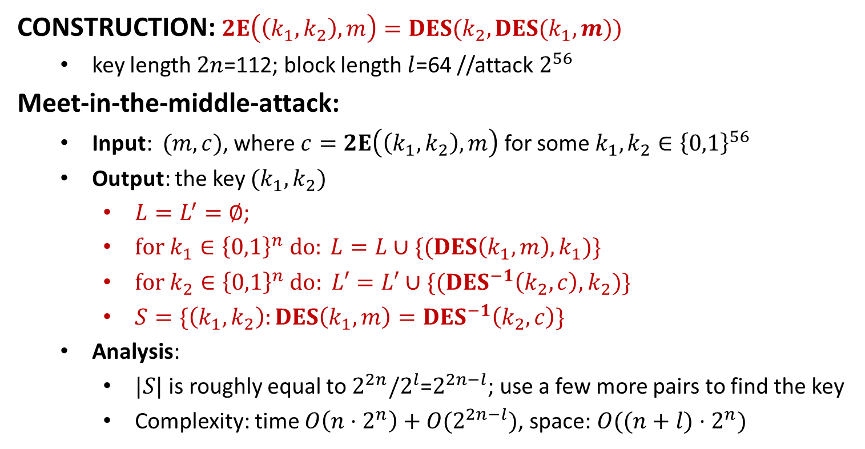
Double DES
CONSTRUCTION: $2E\left(\left(k_{1},k_{2}\right), m\right)=DES(k_{2},DES(k_{1},m))$
key length $2n$=112; block length $l$=64 //attack $2^{56}$
Meet-in-the-middle-attack:
Input: $(m,c)$, where $c=2E\left(\left(k_{1},k_{2}\right), m\right)$ for some $k_{1},k_{2}∈{\left\{0,1\right\}}^{56}$
Output: the key $(k_{1},k_{2})$
$L=L^{′}=∅$;
$for k_{1}∈{\left\{0,1\right\}}^{n} do: L=L∪\{(DES\left(k_{1},m\right),k_{1})\}$
$for k_{2}∈{\left\{0,1\right\}}^{n}$ $do: L′=L′∪\{(DES^{−1}\left(k_{2},c\right), k_{2})\}$
$S=\{\left(k_{1},k_{2}\right):DES\left(k_{1},m\right)=DES^{−1}\left(k_{2},c\right)\}$
Analysis:
$|S|$ is roughly equal to $2^{2n}/2^{l}$=$2^{2n−l}$; use a few more pairs to find the key
Complexity: time $O\left(n⋅2^{n}\right)+O(2^{2n−l})$, space: $O((n+l)⋅2^{n})$

Slide 3
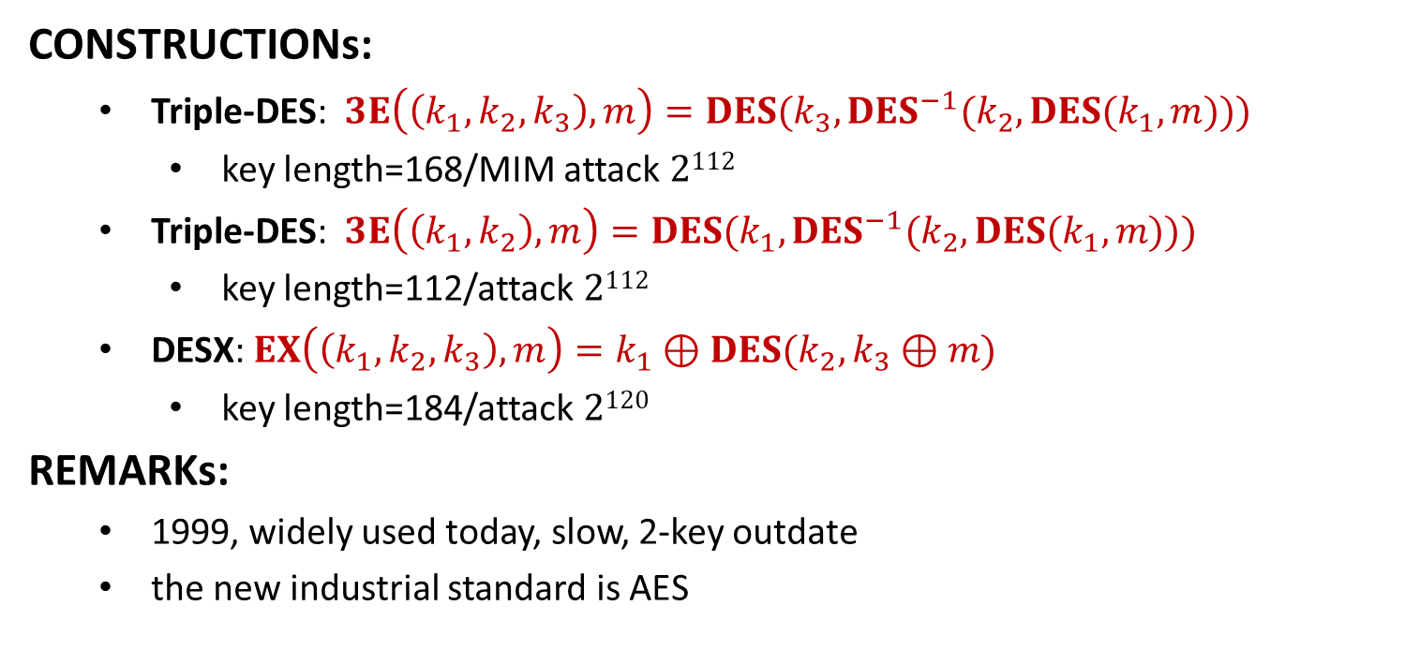
Triple DES
CONSTRUCTIONs:
Triple-DES: $3E\left(\left(k_{1},k_{2},k_{3}\right), m\right)=DES(k_{3},DES^{−1}(k_{2},DES(k_{1},m)))$
key length=168/MIM attack $2112$
Triple-DES: $3E\left(\left(k_{1},k_{2}\right), m\right)=DES(k_{1},DES^{−1}(k_{2},DES(k_{1},m)))$
key length=112/attack $2112$
DESX: $EX\left(\left(k_{1},k_{2},k_{3}\right),m\right)=k_{1}⊕DES(k_{2},k_{3}⊕m)$
key length=184/attack $2120$
REMARKs:
1999, widely used today, slow, 2-key outdate
the new industrial standard is AES

Slide 5
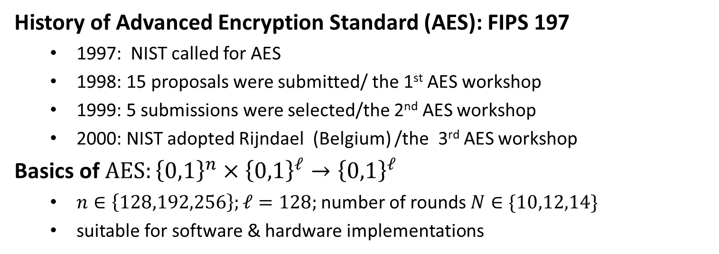
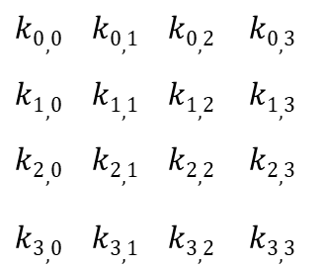
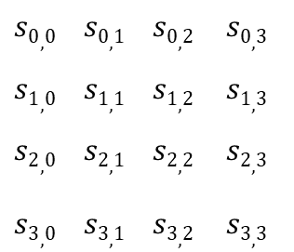
Advanced Encryption Standard
History of Advanced Encryption Standard (AES): FIPS 197
1997: NIST called for AES
1998: 15 proposals were submitted/ the 1st AES workshop
1999: 5 submissions were selected/the 2nd AES workshop
2000: NIST adopted Rijndael (Belgium) /the 3rd AES workshop
Basics of $AES:{\left\{0,1\right\}}^{n}×{\left\{0,1\right\}}^{ℓ}→{\left\{0,1\right\}}^{ℓ}$
$n∈\left\{128,192,256\right\};ℓ=128;$number of rounds $N∈\{10,12,14\}$
suitable for software & hardware implementations
$$s0,0 s0,1 s0,2 s0,3$$
$$s1,0 s1,1 s1,2 s1,3$$
$$s2,0 s2,1 s2,2 s2,3$$
$$s3,0 s3,1 s3,2 s3,3$$
$$k0,0 k0,1 k0,2 k0,3$$
$$k1,0 k1,1 k1,2 k1,3$$
$$k2,0 k2,1 k2,2 k2,3$$
$$k3,0 k3,1 k3,2 k3,3$$
128-bit
key version
State (16 bytes)
Key (16 Bytes)

Slide 6

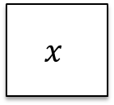



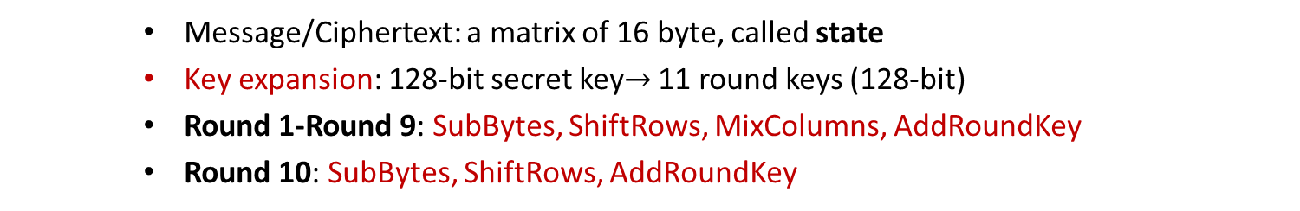

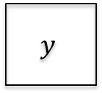
AES Encryption
128-bit
secret key $K$
Key expansion
$$K^{0}$$
$$K^{1}$$
$$K^{2}$$
$$K^{10}$$
128-bit round keys
AddRoundKey
4
4
SubBytes
ShiftRows
MixColumns
SubBytes
ShiftRows
MixColumns
SubBytes
ShiftRows
$$x$$
⨁
$$y$$
4
⨁
⨁
⨁
⨁
4
Round 1
Round 2
Round 10
Message/Ciphertext: a matrix of 16 byte, called state
Key expansion: 128-bit secret key$→$ 11 round keys (128-bit)
Round 1-Round 9: SubBytes, ShiftRows, MixColumns, AddRoundKey
Round 10: SubBytes, ShiftRows, AddRoundKey

Slide 7
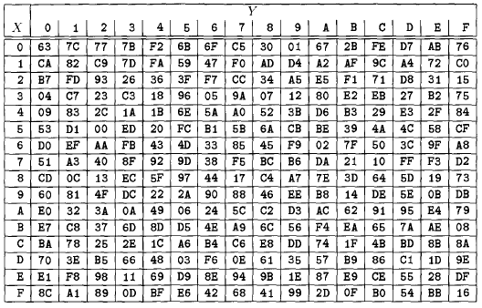
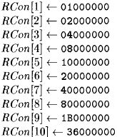


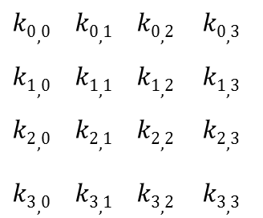



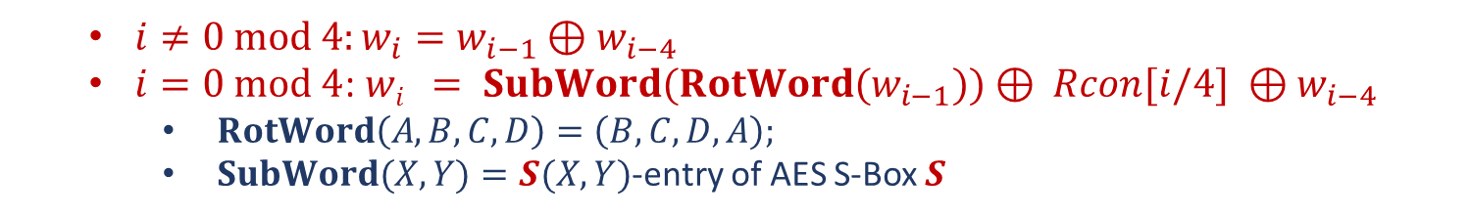


Key Expansion
$$K$$
$S$: AES S-Box
Constants
$$k0,0 k0,1 k0,2 k0,3$$
$$k1,0 k1,1 k1,2 k1,3$$
$$k2,0 k2,1 k2,2 k2,3$$
$$k3,0 k3,1 k3,2 k3,3$$
$$w0 w1 w2 w3 w4 w5 w6 w7 w8 w9 w42 w43$$
$$⋯$$
$$K^{0}$$
$$K^{1}$$
$$K^{2}$$
$$K^{10}$$
$i≠0 mod 4:w_{i}=w_{i−1}⊕w_{i−4}$
$i=0 mod 4$: $wi = SubWord(RotWord(w_{i−1}))⊕ Rcon[i/4] ⊕w_{i−4}$
$RotWord\left(A,B,C,D\right)=\left(B,C,D,A\right);$
$SubWord(X,Y)=S(X,Y)$-entry of AES S-Box $S$

Slide 8
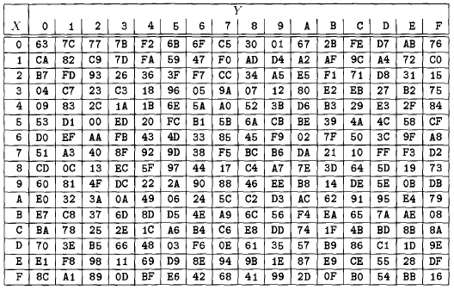
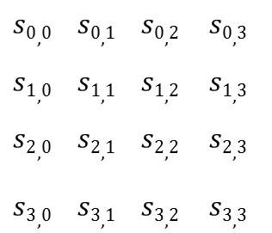

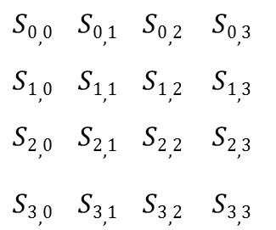
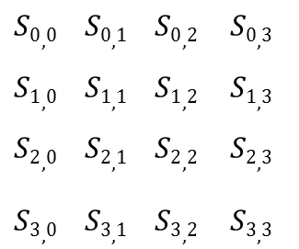
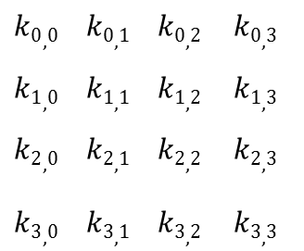

AddRoundKey and SubBytes
AddRoundKey($s,K^{i}$): XOR the state $s$ with the round key $K^{i}$
$$s0,0 s0,1 s0,2 s0,3$$
$$s1,0 s1,1 s1,2 s1,3$$
$$s2,0 s2,1 s2,2 s2,3$$
$$s3,0 s3,1 s3,2 s3,3$$
$$k0,0 k0,1 k0,2 k0,3$$
$$k1,0 k1,1 k1,2 k1,3$$
$$k2,0 k2,1 k2,2 k2,3$$
$$k3,0 k3,1 k3,2 k3,3$$
$$S0,0 S0,1 S0,2 S0,3$$
$$S1,0 S1,1 S1,2 S1,3$$
$$S2,0 S2,1 S2,2 S2,3$$
$$S3,0 S3,1 S3,2 S3,3$$
$$→$$
SubBytes($s$): $\left(X,Y\right)←S\left(X,Y\right), \left(X,Y\right)=s_{i,j}$ is any entry of the state
$$s0,0 s0,1 s0,2 s0,3$$
$$s1,0 s1,1 s1,2 s1,3$$
$$s2,0 s2,1 s2,2 s2,3$$
$$s3,0 s3,1 s3,2 s3,3$$
$$S0,0 S0,1 S0,2 S0,3$$
$$S1,0 S1,1 S1,2 S1,3$$
$$S2,0 S2,1 S2,2 S2,3$$
$$S3,0 S3,1 S3,2 S3,3$$
$$→$$

Slide 9
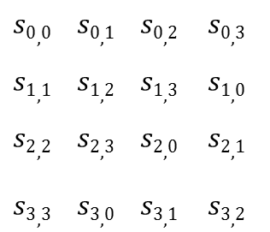

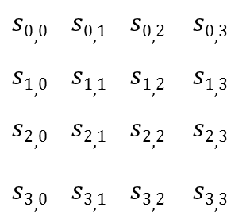

ShiftRows and MixColumns
ShiftRows($s$): shift the rows of the state to the left
$$s0,0 s0,1 s0,2 s0,3$$
$$s1,0 s1,1 s1,2 s1,3$$
$$s2,0 s2,1 s2,2 s2,3$$
$$s3,0 s3,1 s3,2 s3,3$$
$$s0,0 s0,1 s0,2 s0,3$$
$$s1,1 s1,2 s1,3 s1,0$$
$$s2,2 s2,3 s2,0 s2,1$$
$$s3,3 s3,0 s3,1 s3,2$$
$$→$$
MixColumns($s$): Multiplications over $𝔽_{2^{8}}$
02 03 01 01
01 02 03 01
01 01 02 03
03 01 01 02
$$s0,0 s0,1 s0,2 s0,3$$
$$s1,0 s1,1 s1,2 s1,3$$
$$s2,0 s2,1 s2,2 s2,3$$
$$s3,0 s3,1 s3,2 s3,3$$
$$S0,0 S0,1 S0,2 S0,3$$
$$S1,0 S1,1 S1,2 S1,3$$
$$S2,0 S2,1 S2,2 S2,3$$
$$S3,0 S3,1 S3,2 S3,3$$
*
$$→$$

Slide 10
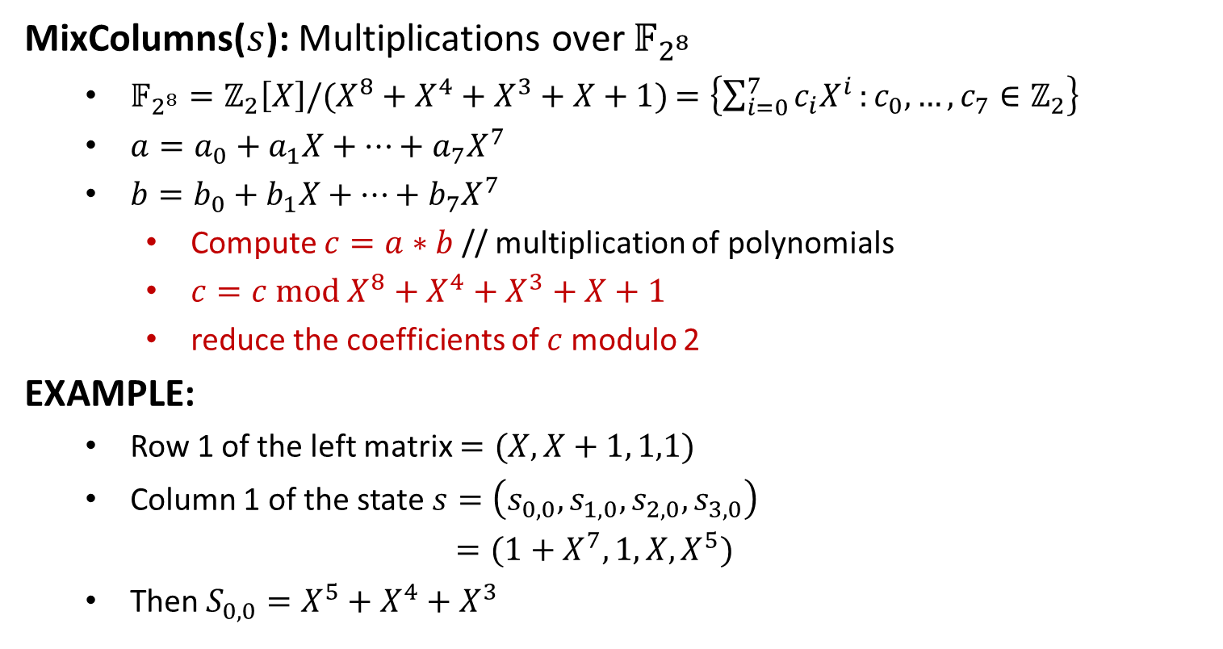
MixColumns
MixColumns($s$): Multiplications over $𝔽_{2^{8}}$
$𝔽_{2^{8}}=ℤ_{2}\left[X\right]/(X^{8}+X^{4}+X^{3}+X+1)$ $=\left\{\sum_{i=0}^{7}{c_{i}X^{i}}:c_{0},…,c_{7}∈ℤ_{2}\right\}$
$a=a_{0}+a_{1}X+⋯+a_{7}X^{7}$
$b=b_{0}+b_{1}X+⋯+b_{7}X^{7}$
Compute $c=a∗b$ // multiplication of polynomials
$c=c mod X^{8}+X^{4}+X^{3}+X+1$
reduce the coefficients of $c$modulo 2
EXAMPLE:
Row 1 of the left matrix $=(X, X+1, 1,1)$
Column 1 of the state $s=\left(s_{0,0},s_{1,0},s_{2,0},s_{3,0}\right)$
$=(1+X^{7}, 1,X,X^{5})$
Then $S_{0,0}=X^{5}+X^{4}+X^{3}$

Slide 11
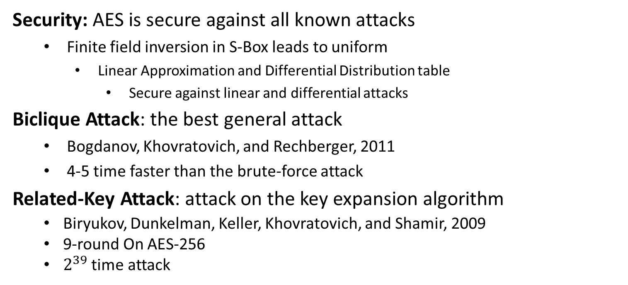
Analysis of AES
Security: AES is secure against all known attacks
Finite field inversion in S-Box leads to uniform
Linear Approximation and Differential Distribution table
Secure against linear and differential attacks
Biclique Attack: the best general attack
Bogdanov, Khovratovich, and Rechberger, 2011
4-5 time faster than the brute-force attack
Related-Key Attack: attack on the key expansion algorithm
Biryukov, Dunkelman, Keller, Khovratovich, and Shamir, 2009
9-round On AES-256
$2^{39}$ time attack

Slide 13
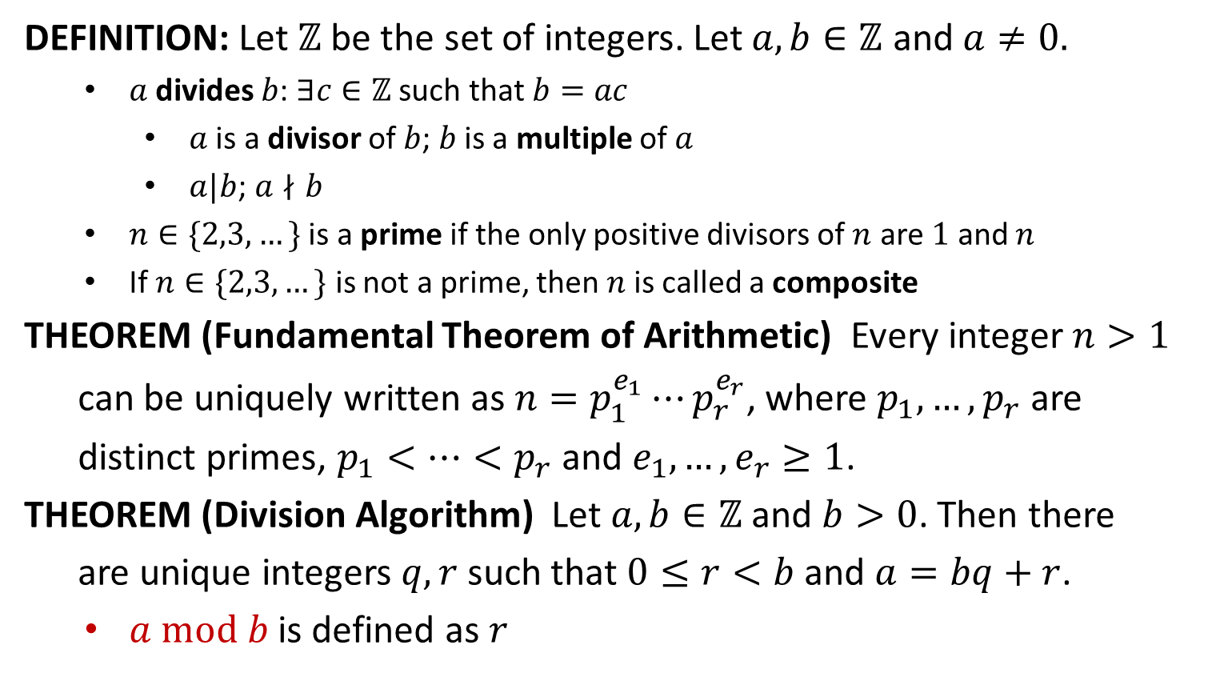
Divisibility
DEFINITION: Let $ℤ$ be the set of integers. Let $a,b∈ℤ$ and $a≠0.$
$a$ divides $b$: $∃c∈ℤ$ such that $b=ac$
$a$ is a divisor of $b$; $b$ is a multiple of $a$
$a|b$; $a∤b$
$n∈\{2,3,…\}$ is a prime if the only positive divisors of $n$ are $1$ and $n$
If $n∈\{2,3,…\}$ is not a prime, then$n$is called a composite
THEOREM (Fundamental Theorem of Arithmetic) Every integer $n>1$
can be uniquely written as $n=p_{1}^{e_{1}}⋯p_{r}^{e_{r}}$, where $p_{1},…,p_{r}$ are
distinct primes, $p_{1}<…<p_{r}$ and $e_{1},…,e_{r}≥1$.
THEOREM (Division Algorithm) Let $a,b∈ℤ$ and $b>0$. Then there
are unique integers $q,r$ such that $0≤r<b$ and $a=bq+r$.
$a mod b$ is defined as $r$

Slide 14
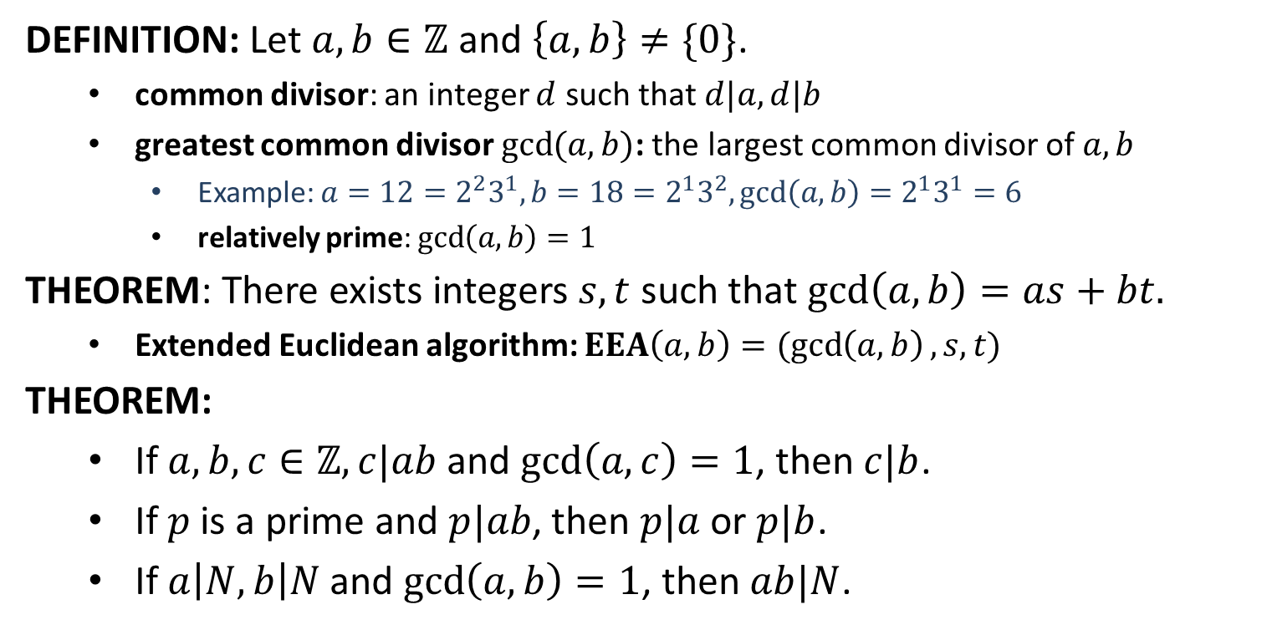
Greatest Common Divisor
DEFINITION: Let $a,b∈ℤ$ and $\left\{a,b\right\}≠\{0\}$.
common divisor: an integer $d$ such that $d|a, d|b$
greatest common divisor $\gcd{(a,b)}$: the largest common divisor of $a,b$
Example: $a=12=2^{2}3^{1}, b=18=2^{1}3^{2}, gcd\left(a,b\right)=2^{1}3^{1}=6$
relatively prime: $\gcd\left(a,b\right)=1$
THEOREM: There exists integers $s,t$ such that $\gcd\left(a,b\right)=as+bt.$
Extended Euclidean algorithm: $EEA\left(a,b\right)=(\gcd\left(a,b\right), s,t)$
THEOREM:
If $a,b,c∈ℤ, c|ab$and $\gcd\left(a,c\right)=1$, then $c|b$.
If $p$ is a prime and $p|ab$, then $p|a$ or $p|b$.
If $a\left|N, b\right|N$ and $\gcd\left(a,b\right)=1$, then $ab|N$.

Slide 15
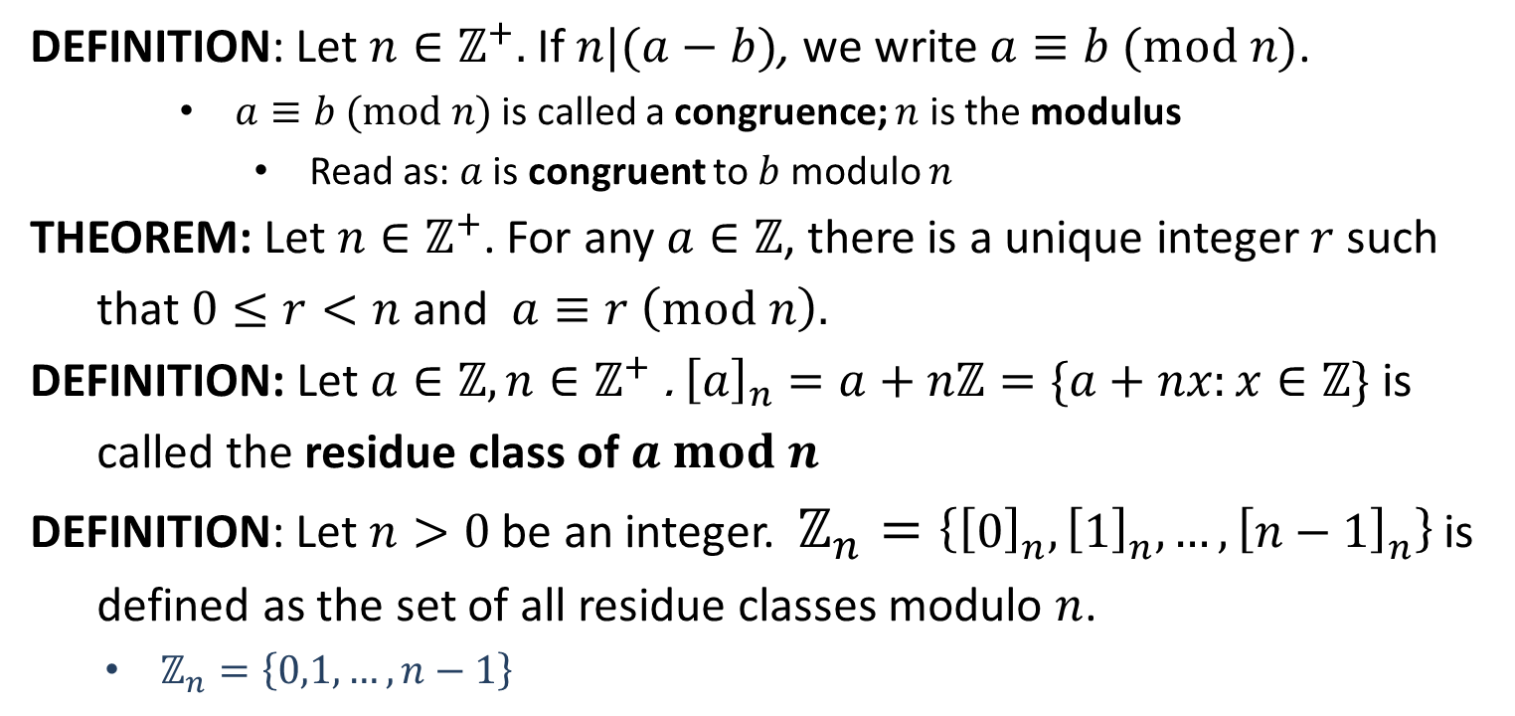
Congruence
DEFINITION: Let $n∈ℤ^{+}.$ If $n|(a−b)$, we write $a≡b (mod n)$.
$a≡b (mod n)$ is called a congruence; $n$ is the modulus
Read as: $a$ is congruent to $b$ modulo $n$
THEOREM: Let $n∈ℤ^{+}$. For any $a∈ℤ$, there is a unique integer $r$ such
that $0≤r<n$ and $a≡r \left(mod n\right).$
DEFINITION: Let $a∈ℤ,n∈ℤ^{+}$. ${\left[a\right]}_{n}=a+nℤ=\{a+nx:x∈ℤ\}$ is
called the residue class of $a mod n$
DEFINITION: Let $n>0$ be an integer. $ℤ_{n}=\left\{{\left[0\right]}_{n}, {\left[1\right]}_{n}, …, {\left[n−1\right]}_{n}\right\}$ is
defined as the set of all residue classes modulo $n$.
$ℤ_{n}=\left\{0,1,…,n−1\right\}$

